Slide 1

COMPANY SNAPSHOT

Slide 2



Who we are 👋🏻
The era of AI is here. helps you lead it.
We’re a global crew of AI builders, helping you use AI in ways that make sense –
no hype; just simple, value-adding technology. Think of it as Intelligence on tap: with us designing AI agents that help you move faster, create more quality stuff, and reach more of the people you serve.
Our core technology partners
and more…

Slide 3

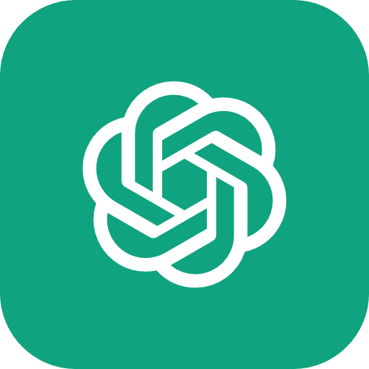
AI chatbots like ChatGPT are just the beginning.
While an AI Chatbot tells you the actions to do. AI agents actually do the actions for you.
And because they can run 24/7, scale at low cost, and never burn out - you can 100x your productivity and grow smarter (and faster).
But it all depends on smart design: how well the AI Agent’s built determines the value that you get.
What’s an AI Agent? (and why get one?)
AI Chatbot
AI Agent
🤖
“gives you the actions to do” | “does the actions for you”
🧑🏻: “I want to send an email 📧” | 🧑🏻: “I want to send an email 📧”
🤖: “Here’s a draft you can copy to gmail” | 🤖: “That email has been sent!”
AI agents don’t have to be chat-based—they can run on a schedule or trigger actions, like sending you their draft work on your favorite messaging app, which you can approve before they post it.

Slide 4
What are the AI Agents that we build?
🤖
There’s 3 types, and they basically let you…
Save time ⏱️ | Reach more 🚀 | Create more 🍳
AI Agents handle tasks you didn’t know can be automated. If it’s manual, repetitive, or text-based - there’s now probably a smarter way. | AI Agents help you reach more people without more effort. They distribute your content across platforms, automatically - so one post becomes many. | AI Agents help you create more content from less. Whether you’re remixing what you got or generating something new - it’s now all possible.
Client X wanted to automate replies to brand sponsorship offers —now their AI agent handles it instantly, no manual sifting needed.
Client Y needs to create tailored proposals after every sales call—AI listens to the transcript and designs the template on the spot.
Client Z needs to track content analytics across platforms—AI pulls the numbers and drops them straight into their spreadsheet.
Our AI education account (difficult tech-specific niche to grow in) RoboNuggets grew to 60k followers, 6.2M impressions just by auto-posting from TikTok to Instagram.
FYI: Some accounts post 100+ times a day using automation. There’s no ceiling.
Recent examples:
This channel grew to 900k followers by consistently publishing AI POV content.
This video blew up by turning popular memes into baby videos across social platforms.
Bonus tip: Check the comments on those channels—people are fine with AI-generated content as long as it’s clearly AI-labeled and are fun or educational.

Slide 5
Want to learn more?
If you're curious on how AI can bring the work you do to the future - drop us a note at team@robonuggets.com

